Slide 1

Global Payments – Proposed resources
October 2020

Slide 2
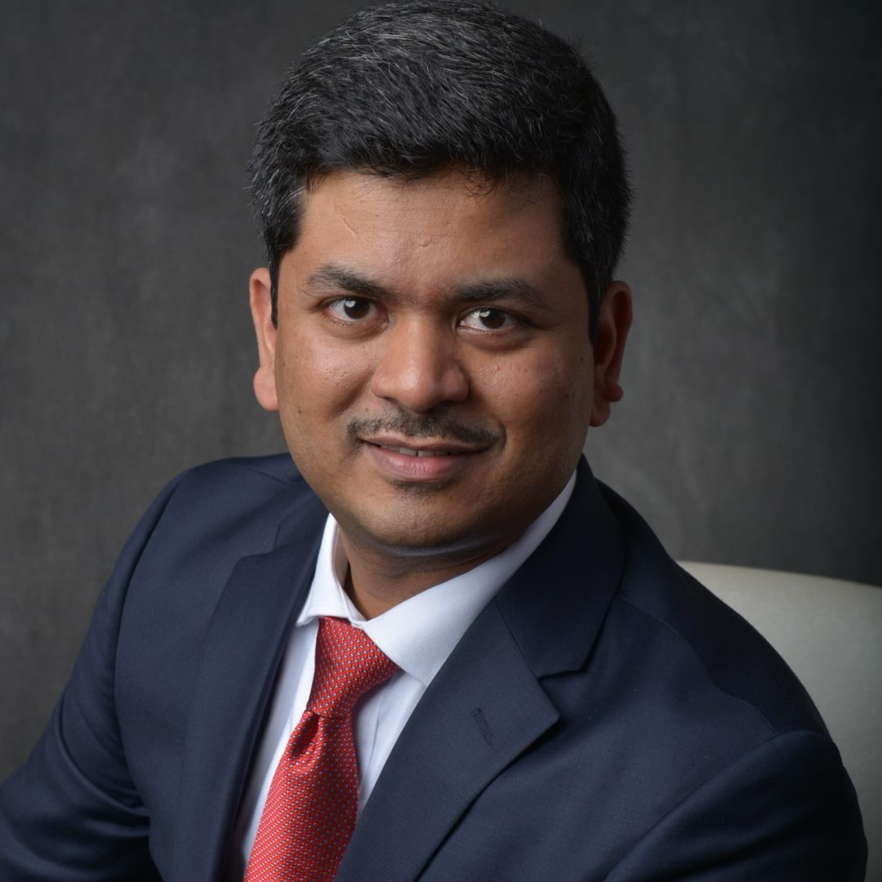
Harshad Kamerkar
Director harshad.kamerkar@pwc.com
(301) 979-1754
Relevant experience
Lead an Application Analysis & Disposition project for ~120 applications at Global Payments Inc (Merchant business). The assessment included data gathering, cleaning, application assessment (technical, functional and financial) and analysis for assessment dispositions - Retain, Retire, Re-engineer and Leverage. Based on the information gathered, conducted cloud feasibility assessment to identify applications suited for cloud migration / replatform
For an automobile finance company, led a study to evaluate options to improve the application portfolio, confirm the target architecture, evaluate hosting strategies as part of the next phase of client’s data center optimization program, and identify potential risks that need to be addressed
For a mid-sized bank, led solution architecture and implementation of an cloud based SaaS Integrated Core Banking platform (Lending and Deposits) and Presentation Layer. Managed the RFP vendor selection process, performed gap analysis , technology due diligence and documented the high level solution architecture. Led the delivery team for end to end strategy through execution delivery of the digital solution
Conducted current state architecture assessment for the advisor facing portal for the largest independent financial advisor firm. Identified gaps, risks and issues in application architecture, data management & platform resiliency, provided prioritized recommendations and roadmap for implementation keeping scope & timeline into consideration. Helped set up the Architecture Review board and Enterprise Architecture functions with principles driven and consensus based standards, tools and processes
Other experience
Led the design and development of cloud based PaaS platform, Appian business process management system, for a Global Alternative Investments Asset Management firm for the Investment profiles, Expense allocation and deal code governance processes. Integrated with multiple backend systems using web services and ETL data integration
Meet Harshad
Harshad has 16+ years of IT consulting experience in assisting financial services clients to improve their operational business processes while lowering the operational costs. His clients span across retail banking, payments processors, consumer finance, wealth management, automobile lending & leasing, P&C insurance/claims management and small business banking domains. He is a trained enterprise architect as well as has hands on experience to successfully deliver quality business solutions with expertise in analysis, design, development and implementation of Enterprise Content Management (ECM), Business Process Management (BPM), Web Portals, Mobile Development and business systems/applications using Java, JEE, Service Oriented Architecture based modular software components and Web services.

Slide 3
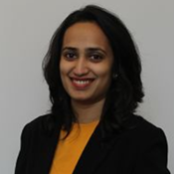
Manali Killedar
Senior Associate manali.k.killedar@pwc.com
(412) 628-3472
Relevant experience
Lead an Application Analysis & Disposition project for ~120 applications at Global Payments Inc (Merchant business). The assessment included data gathering, cleaning, application assessment (technical, functional and financial) and analysis for assessment dispositions - Retain, Retire, Re-engineer and Leverage. This effort created an extensive data inventory for the client and provided a directional guidance for the applications
Lead an Enterprise Tools’ Analysis effort at Global Payments Inc. to identify synergy opportunities and realize them by consolidation of tools. The assessment involved gathering all the tools’ data, analyzing and identifying opportunities for consolidation by associating tools that are similar in functionalities. Further, she also leads a team who is facilitating discussions with tool users and vendors to determine the benefits of the consolidation and helping the users build a high-level migration roadmap.
Other experience
Lead business and technical requirement gathering for client’s pricing tool for their reinsurance business. As a scrum master, she coordinated between workstreams and provided oversight to the technical team
Built a forecasting algorithm to track agent utilization and productivity gaps for client’s call center business. Lead the team to gather client requirements and prioritized deliverables for them.
Meet Manali
Manali Killedar is a Senior Associate in the PwC FS Advisory, Digital & Technology Innovation practice. Manali’s key areas of expertise is in data analysis, business intelligence, process automation, machine learning and project management in financial services. Prior to PwC, she has worked with J.P. Morgan Chase as a Java and Python developer.
Manali did her under graduation in Information Technology Engineering from University of Mumbai. She has attained her graduation in Business Intelligence and Data Analytics with specialization in Machine Learning techniques from Carnegie Mellon University.
Manali is also a SAFe Certified Scrum Master and SAFe Agilist

Slide 4
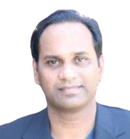
Vijay Polsani
Director vijay,polsani@pwc.com
(650)-777-7634
Relevant experience
Technical ownership and program delivery; extensive experience in Cloud Transformations; Solutioning, Infrastructure Modernization
> Technical Strategy, Architecture, and Engineering rollouts using Microservices, API-first design, Container orchestration, and application security as foundational components.
> A.I: Automation using NLP based chatbots, Recommendation engines, IVR modernization, Feature engineering and model building for M.L
> Customer Identity Management: CIAM identity integrations and Secure access management
> DevSecOps: Canary deployments, Deployment automation, and workflow orchestrations
Built extensive software Architecture Blueprint's, Managed Cloud, Development & Support, Shrink Wrapped Open Source Software, customized digital Insights. Portfolio Management & Wealth Management Advisory software platform build.
Design and built containerized Kubernetes deployable applications with sidecar using Istio. Security with Calico or Cloud internal secure pod communications. Apigee external proxy with internal Envoy and Load Balancers.
Other experience
Technical Excellence: In-depth hands-on expertise in building software that are designed using API-First, Security-First, and Cloud-Native approach. Re-architecting monolith to microservices, data management, network design and hybrid cloud deployments of enterprise on providers.
Ownership & Teaming: Recognized for leading high-performance engineering teams. Championed best in-class engineering culture. Managing success metrics, on-time delivery and cross-functional collaboration.
Customer Focused: Customer obsessed delivery through fail-fast agile process, whiteboarding and defining agreeable MVP. Strive for early stakeholder buy-in.
Vijay Polsani
Vijay has 20+ years of experience in building world class software applications and products across capital markets, banking, payment processors to multiple clients. Architect, Advisor, and Analyst of technology consulting with rich experience in building software products and enterprise applications.
Manage and deliver applications using API-First, Security-First, Cloud-Native and Hybrid enterprise landscape. Bootstrap new divisions with start-up culture, re-architect monolith to microservices, Data management. Hybrid cloud and network design for cloud transformations (GCP, Azure Cloud, AWS)
Certified Cloud Architect - GCP, AWS
Certified Java Developer, Certified WSO2 Identity Server
Program Management, Agile/Scrum delivery process

Slide 5
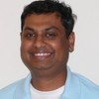
Shiby Surendranath
shiby.Surendranath@pwc.com
(510)-284-7430
Relevant experience
For a Global Bank led solution architecture and implementation of the global rollout out Account Opening, Account Maintenance and Tax Regulation process automation initiative. Responsible for identifying and establishing processes for reuse of technology assets. Utilized a data driven approach to requirements prioritization and a microservices driven architecture. Engaged in process improvement analysis and rollout based on application usage in production.
Lead the modernization of process automation solution for the Wealth Management subsidiary of a Fortune 500 bank. As a process architect responsible for the migration of wealth management onboarding, maintenance and model based portfolio management solutions from a legacy broker dealer platform to BPM. Responsible for process analysis, process rationalization and hands-on delivery of the rollout. Assisted the bank with its shared services initiative.
Other experience
Technical Excellence: A diverse background in web, bpm and microservices based technologies. A strong track record delivering customer facing web applications, microservices based integration architectures and process improvement data analysis.
Execution Methodology: An agile based approach to project delivery, aligned with clients methodologies and organization culture. Take a proof of concept based iterative approach to requirements definition and alignment with project goals.
Certifications: IBMBPM Process Management Certified, Java developer certified. In the process of ML based AI certification.
Meet Shiby
Season track record with delivering focused BPM and Services based software solutions across Capital markets, Banking and Insurance domains, for Fortune 500 companies.
Goal oriented approach to executing business process automation projects. Demonstrable experience with assisting clients establish process goals, to stay focused and deliver to established program goals. Good leadership qualities to help steer deliverable priorities and quality. Hand-on “Solutions Architect”, utilizing iterative playbacks to quickly prototype, evolve solutions based on frequent customer feedback.

Slide 6
© 2020 PwC. All rights reserved. PwC refers to the US member firm or one of its subsidiaries or affiliates, and may sometimes refer to the PwC network. Each member firm is a separate legal entity. Please see www.pwc.com/structure for further details. This proposal is protected under the copyright laws of the United States and other countries. This proposal contains information that is proprietary and confidential to PricewaterhouseCoopers LLP, and shall not be disclosed outside the recipient's company or duplicated, used or disclosed, in whole or in part, by the recipient for any purpose other than to evaluate this proposal. Any other use or disclosure, in whole or in part, of this information without the express written permission of PricewaterhouseCoopers LLP is prohibited.

